Slide 1


ZOMATO-Analysis for opening New Restaurant
BY- Vidyadhar Dhopte

Slide 2

AGENDA
Introduction
Problem statement
Analysis
Dashboard
Conclusion.

Slide 3

ABOUT ZOMATO
Established in 2010, Zomato’s tech platform links customers, restaurant partners, and delivery partners, meeting their various needs. Customers use this platform to find restaurants, share reviews and photos, order food, book tables, and handle payments. Meanwhile, They equip restaurant partners with marketing tools, offer reliable delivery services, and supply quality ingredients through Hyperpure. It also provide transparent earning opportunities for delivery partners (Zomato.com, 2024).

Slide 4
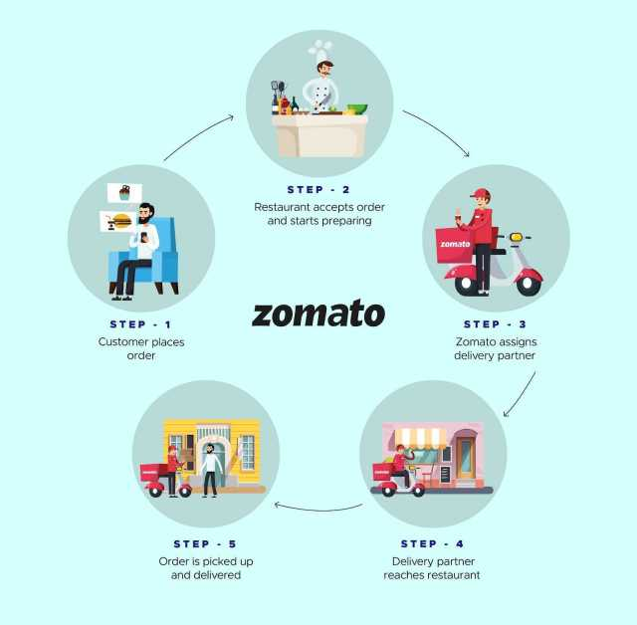
Zomato’s Ecosystem
Pal D., 2020

Slide 5
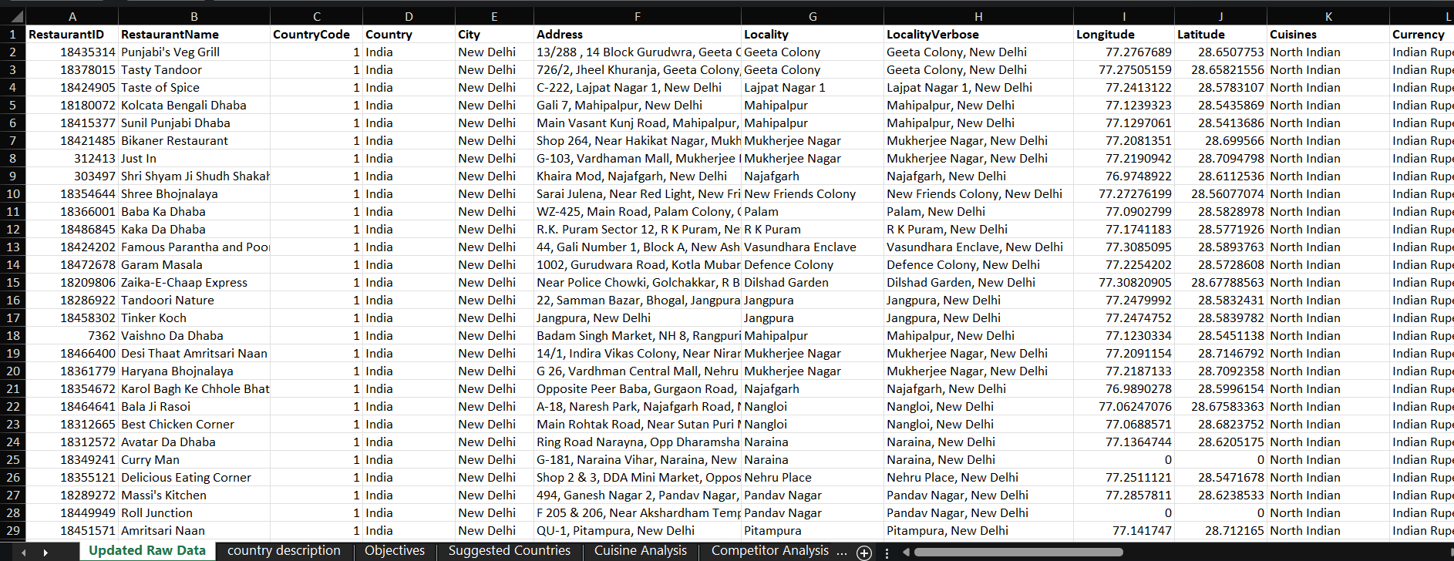
Problem Statement
You are hired as a consultant data analyst by Zomato where the team is looking for expansion and opening more restaurants. Your task is to develop strategies/suggestions for opening newer restaurants.

Slide 6
PRIMARY OBJECTIVES
Global Market Expansion.
Revenue Growth.
Brand Recognition
Restaurants Partnership.
Quality.

Slide 7
DATA OVERVIEW
The data given consists, name of the restaurants over country like Australia, China, India, Indonesia, South Africa, Qatar, Sri Lanka, UK, USA, New Zealand, Singapore, Canada, etc.
Data Cleaning and processing:
During the data cleaning, Sort & filter was used to filter out the duplicates and blanks were removed. No further data cleaning was required.
While observing the data, it can be seen that from the overview detailed information is given about the restaurants, its ratings, address, etc.
This dataset gives the deep understanding of the Zomato’s visions.
By comparing the different attributes we can get a clear picture of Zomato’s strategy of opening new restaurants in new country.

Slide 8
Analytical Approach and Tools
Data Cleaning: Utilized tools like Sort & Filter to select the blanks and remove it and to check if there are any duplicates or not.
Data Enrichment: Enhanced the data with additional variables like VLOOKUP to cross reference external data sources.
Descriptive Analysis: Used Pivot Tables by using different attributes and comparing the results across different countries and find best option to open new restaurants.
Visualization: Created interactive charts and dashboard for data representation for interactive communication and understanding.

Slide 9
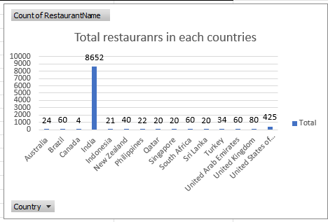
NUMBER OF RESTAURANTS OPENED IN COUNTRIES
Insight: India dominates with 8,652 restaurants, reflecting its vast and diverse market, while the United States (425) and the United Kingdom (80) represent significant but smaller opportunities in mature markets. Emerging markets like the UAE, Brazil, South Africa (60 each), and Turkey (34) show growth potential, whereas countries like Canada (4), Indonesia (21), and Australia (24) remain underrepresented but promising
Recommendation: Focus on regional diversity and affordability in India, expand localized and high-quality offerings in the US and UK, and target upscale international cuisines in the UAE, Brazil, and South Africa. For smaller markets like Canada, Indonesia, and Australia, pilot niche concepts tailored to local preferences, such as modern Australian cuisine or affordable fusion dining.

Slide 10
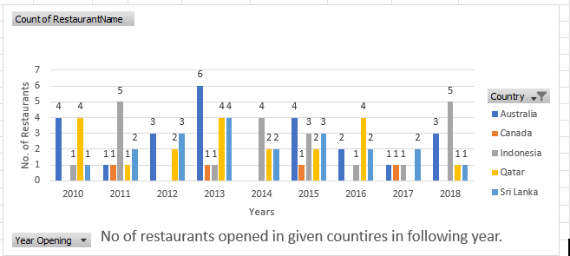
Number of restaurants opened each year in selected countries
Insights:
Australia had the highest number of openings (24), showing consistent growth. Indonesia and Qatar were strong performers with 21 and 20 openings, respectively, indicating significant market opportunities. Canada had the fewest openings (4), suggesting it may be a challenging market. The peak year was 2013 with 16 openings, driven by growth in Australia, Sri Lanka, and Qatar. 2017 saw the lowest activity (5 openings), pointing to potential operational or market challenges
Recommendation:
Focus on expanding further in Australia, Indonesia, and Qatar to capitalize on high growth. Reassess strategies for Canada to address barriers to market entry or growth. Investigate the reasons for the decline in 2017 to avoid future dips in openings.

Slide 11
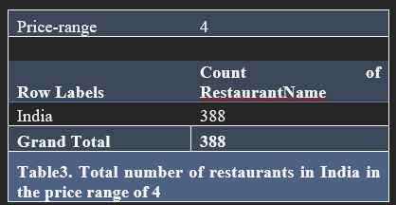
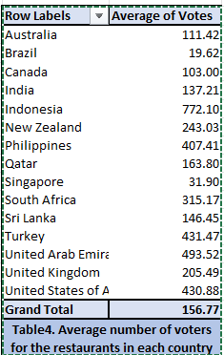
A total number of restaurants in the price range of 4.
Average number of voters for the restaurants in each country according to the data.

Slide 12
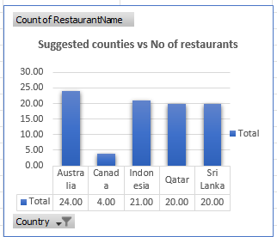
NUMBER OF RESTAURANTS IN SELECTED COUNTRIES
Insights:
Australia (24 restaurants): Leads with the highest number, reflecting strong market demand and focus. Canada (4 restaurants): Underrepresented compared to other countries, suggesting low penetration or fewer opportunities. Indonesia (21 restaurants), Qatar (20 restaurants), Sri Lanka (20 restaurants): Show balanced distribution, indicating a deliberate strategy to maintain presence in these regions. Australia’s dominance highlights its importance as a primary market, while Canada’s low count suggests untapped potential or deprioritization. The similar numbers for Indonesia, Qatar, and Sri Lanka suggest a consistent and targeted approach to these growing markets.
Recommendations:
Canada: Explore untapped potential by conducting market studies and adapting offerings to suit local preferences. Australia: Strengthen market presence by expanding to new cities and using its success as a model for other regions. Indonesia, Qatar, Sri Lanka: Maintain quality, emphasize regional flavors, and assess feasibility for growth in urban and suburban markets. General: Conduct in-depth market research, tailor marketing to cultural nuances, and collaborate with local partners for streamlined expansion. Prioritization: Focus on Canada for growth opportunities, leverage Australia’s established foothold, and target high-demand areas in Indonesia, Qatar, and Sri Lanka for strategic expansion.

Slide 13
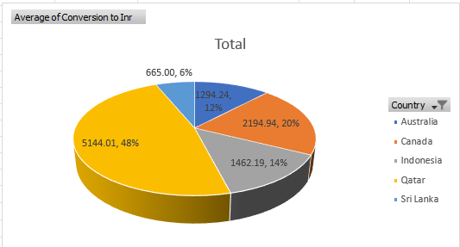
Distribution of expenditure for the countries selected.
The average cost of two people is presented with the help of pivot tables and charts and it can be seen that Sri Lanka has the lowest average cost for two people i.e., INR 665.00, and the highest in Qatar INR .00.
(Spreadsheet: Suggested Countries)

Slide 14
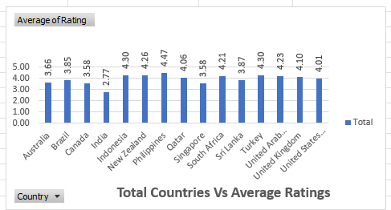
Restaurant quality of the countires
Insights: Countries such as the Philippines (4.47), Turkey (4.30), and Indonesia (4.30) achieved the highest average ratings, indicating exceptional customer satisfaction. India (2.77) has the lowest average, suggesting room for improvement in services. Overall, countries with ratings above 4.0 demonstrate high-quality service and positive customer experiences.
Recommendations: Focus on replicating strategies from high-rated countries like the Philippines and Turkey in underperforming regions such as India. Identify best practices and cultural preferences contributing to higher ratings. In India, conduct customer feedback surveys to address specific pain points and improve service quality, targeting a rating closer to the global average
(Spreadsheet: Objective)

Slide 15
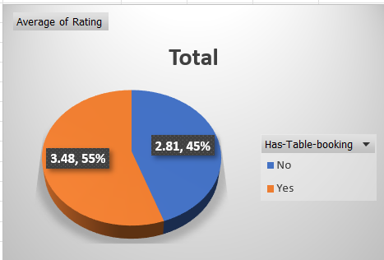
Online Delivery vs Ratings
Insights
Restaurants offering online delivery received higher average ratings (3.29) compared to those that do not (2.75). This suggests that online delivery significantly influences customer satisfaction and enhances their overall experience. The overall average rating is 2.89, indicating room for improvement, particularly for restaurants without online delivery options
Recommendations:
Encourage all restaurants to adopt online delivery services to boost customer ratings and satisfaction. Analyze customer feedback to identify key drivers of satisfaction among online delivery users. Improve operational efficiency for non-delivery restaurants to address gaps impacting lower ratings.
(Spreadsheet: Delivery Analysis)

Slide 16

Table Bookings vs Ratings
Insights: The data suggests that customers who made table bookings rated their experiences higher (3.48) than those who did not (2.81). This indicates that table bookings may enhance customer satisfaction by ensuring smoother service or better seating arrangements. Overall, booked tables contribute significantly to the higher average ratings.
Recommendations: Encourage table bookings by offering incentives such as discounts or priority seating. Promote the benefits of pre-booking through marketing campaigns. Additionally, analyze factors contributing to lower ratings for walk-in customers and improve their experience to narrow the satisfaction gap.
(Spreadsheet: Delivery Analysis)

Slide 17
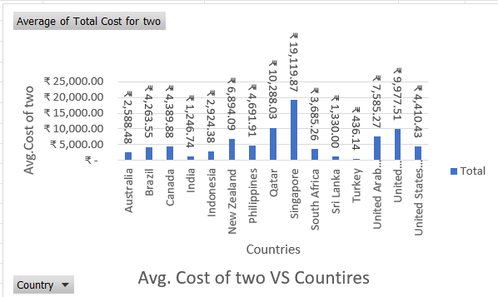
The average cost for two for the countries
Insights:
Lowest Cost Destinations: Turkey (₹436.14) and India (₹1,246.74) are the most affordable options for dining, making them attractive destinations for budget-conscious travelers. Highest Cost Destination: Singapore (₹19,119.87) has the highest dining costs, significantly higher than other countries, indicating luxury or exclusivity. Mid-Range Options: Countries like Brazil, Canada, and the United States offer average costs between ₹4,000 to ₹5,000, balancing affordability and quality
Recommendations:
Budget Travelers: Focus on Turkey, India, and Sri Lanka for dining without compromising cultural experiences. Balanced Options: Countries like the United States, United Kingdom, and Brazil are suitable for travelers seeking moderate luxury without overspending. Destination Marketing: Promote affordability in Turkey and India to attract price-sensitive tourists, while marketing exclusivity for Singapore and Qatar.
(Spreadsheet: Price Range)

Slide 18
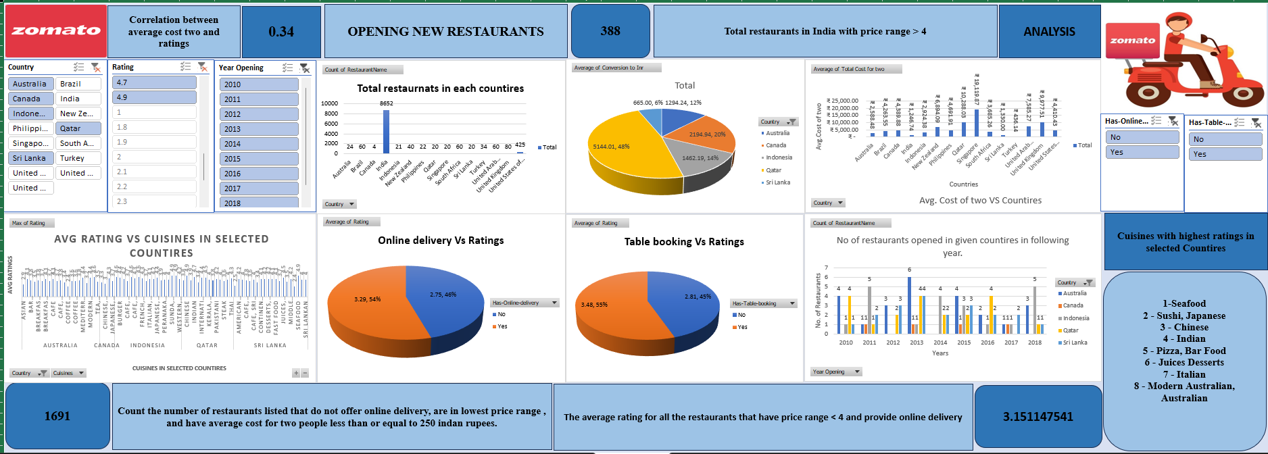
DASHBOARD

Slide 19

CONCLUSION

Slide 20
It’s been concluded that Zomato will open its new restaurants in selected countires. The reason for doing that was the results of a comparison based on different factors.
And those factors are cuisines, ratings, distribution of cost, a platform for doing business, etc.
Analyzed customer bookings via table booking or online delivery, and it was seen that more table bookings were done.
If no instructions were given, the method that I would have followed would be:
If the objective and subjective questions would have not been given, then the approach I would have followed be as follows:
First, I would have read the data given properly and would have started cleaning the raw data in the dataset.
I would have used Sort and filter options and removed duplicates and blanks from the data.

Slide 21
Then, I would make notes on the present data, how it can be analyzed, what attributes can be compared, and where I can get the data to open new restaurants.
Later, by following this new path I would Start making pivot tables and charts and according to the requirements, I would be adding new columns and use string functions, Aggregation and conditional aggregation, and conditional formatting to highlight the cities and their values which are selected to open the latest restaurants.
Thus, using these functions, I would make the pivot tables and charts accordingly.
After this I would start making the dashboard on a new worksheet and make sure that all the data collected in the form of tables and charts would be displayed visually and properly and make sure that the other people understand it properly. A dashboard is used to make the data more visual and easier to understand.
In this way, I would analyze the data by myself.

Slide 22
REFERENCES
Zomato.com, 2024
Pal D., 2020. What happens once an order is placed?. https://blog.zomato.com/food-preparation-time.

